Slide 1
BRASS Scenario 5
Swap Data Acquisition Unit
Adapted from a flight test that occurred in 2012 in F-35 Lightning flight testing at NAS Patuxent River

Slide 2
Scenario #5 – Brief Description
TTC Data Acquisition Unit
This scenario describes a pre-flight situation that involves swapping instrumentation hardware in the test article. The Data Acquisition Unit (DAU) is broken and needs to be replaced by another DAU already in stock from a different manufacturer.
The objective is to configure the new DAU to meet the same requirements as the previous one.
Sensors
TTC Data Acquisition System and Sensors Diagram

Slide 3
Test Article Network
PCM
System
Gateways
IEEE 1588
Grandmaster
Bus Catalogs
MIL-STD-1553
Arinc 429
Arinc 664
Ethernet
Fibre Channel
Firewire
Munitions/Stores
RS-232/422
Voice
Gateway
Time
Source
Local
Data
Storage
Network
Recorder
DAU
Switch
Multifunction
Display
Crew
Display
DAU
Switch
Switch
Measurements
Accelerations
Discrete’s
Flow
Forces/Loads
Positions
Pressures
Temperatures
Torque/Horsepower
Voltages/Currents
DAU to be replaced
Network
Encryptor
DAU
RF
Network
DAU
TA
Resource
Manager
TA
Manager
GSE Cart
TA
Checkout
DAU
Ethernet

Slide 4
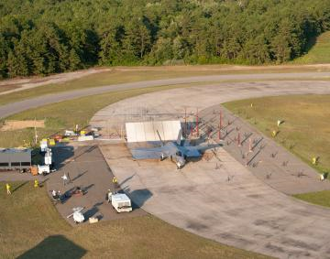
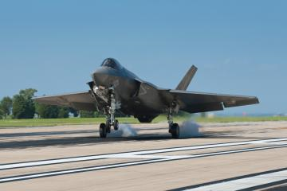
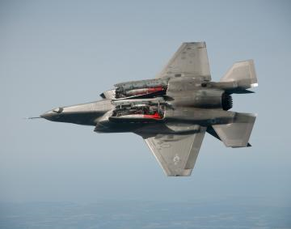
Test Article
Aircraft: F-35B
“More recently, the test team at Pax River has been focusing on dropping weapons from the internal bays of the F-35. The F-35B dropped its first 1,000-pound GBU-32 Joint Direct Attack Munition on 8 August 2012. Here, BF-3 goes through open-door testing with two GBU-32s on Flight 182 in early March 2012. USMC Maj. Richard Rusnok was the pilot.”
“The F-35 Integrated Test Force, or ITF, at Pax, one of multiple test sites for the F-35 program, is responsible for flight testing the seagoing variants of the F-35, which include the short takeoff/vertical landing F-35B variant and the F-35C carrier variant. As of fall 2012, the ITF at Pax operated eight F-35s — five B-models and three C-models with two more F-35Bs and a fourth F-35C slated to arrive before the end of the year.”
http://www.codeonemagazine.com/article.html?item_id=110

Slide 5

Range Infrastructure
Range Network: Naval Air Station Patuxent River (known as NAS Pax River)
Equipment Used:
GSE (Ground Support Equipment)
Equipment Available:
Replacement DAU
“NAS Patuxent River, located on the Maryland coast where the Patuxent River empties into the Chesapeake Bay, is home to Naval Air Systems Command and the Naval Air Warfare Center Aircraft Division. Long known as Pax River, this air station bills itself as “the place where the future of Naval Aviation begins.”
http://www.codeonemagazine.com/article.html?item_id=110

Slide 6
Flight Test Operation Flow

Slide 7
Test Objective: Configure Replacement DAU
Initial configuration/requirements for the TTC DAU
Sample Rate: 128 Hz
Data Length: 16-bit Resolution
8-channel thermocouple card
6-channel signal conditioner card
New configuration/requirements for the Vendor B DAU Replacement
Sample Rate: 100 Hz
Data Length: 8-bit Resolution
4-channel thermocouple card (Quantity: 2)
2-channel signal conditioner card (Quantity: 3)

Slide 8
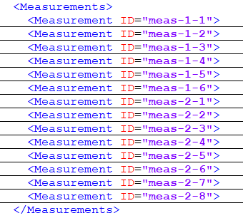
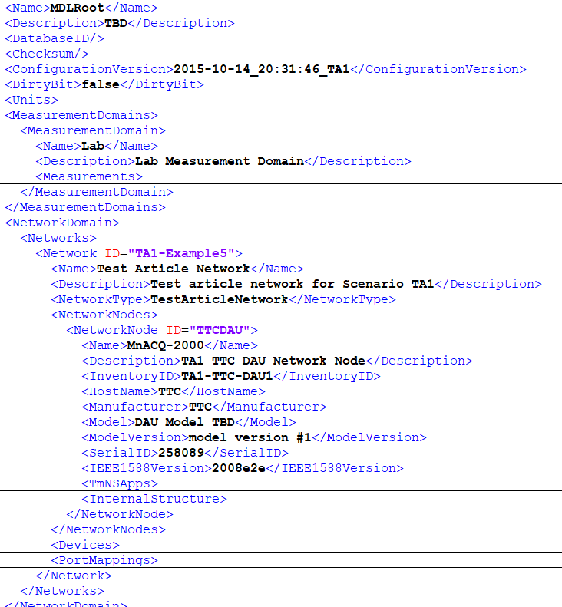
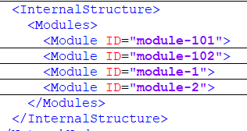
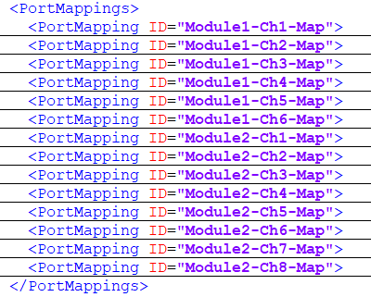
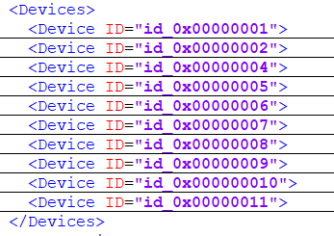
Initial MDL Representation
Internal Structure contains the description of the physical modules that comprise the TTC DAU
Note: Configuration is obtained after requesting the inventory from the data acquisition device
Measurements describes the measurement types for our configuration
Devices describes the properties of the sensors (thermocouples and transducers)
Port Mappings describes the connections between ports in the DAU and sensors
Note: If hardware changes then this area needs to be updated appropriately to capture the new connections

Slide 9
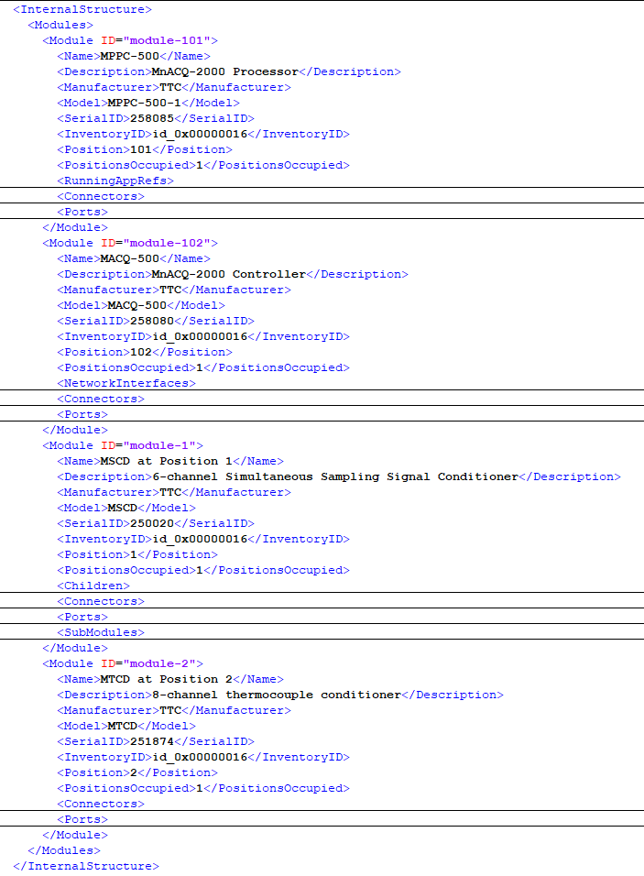
Initial MDL Representation TTC DAU Internal Structure
Note: Configuration is obtained after requesting the inventory from the data acquisition device

Slide 10
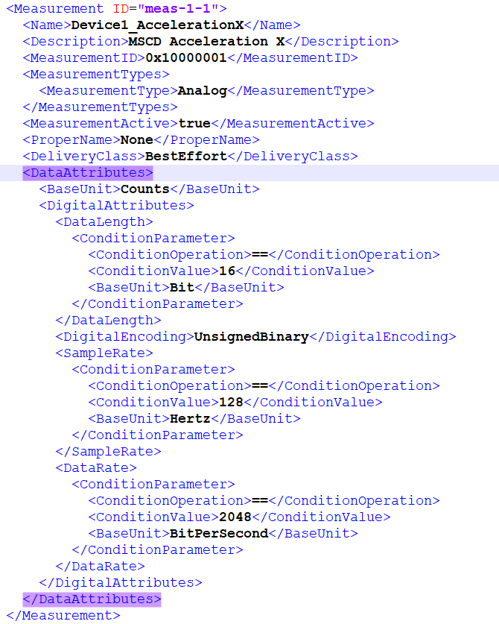
Initial MDL Representation Measurements
Acceleration measurements
Resolution comes from the channel vendor datasheet
Temperature measurements
Sample rate comes from requirements documents and rules of thumb that the instrumentation engineer knows

Slide 11

TTC DAU Datasheet
http://www.ttcdas.com/pdf/nonRegisteredUser/mnacq2000.pdf

Slide 12
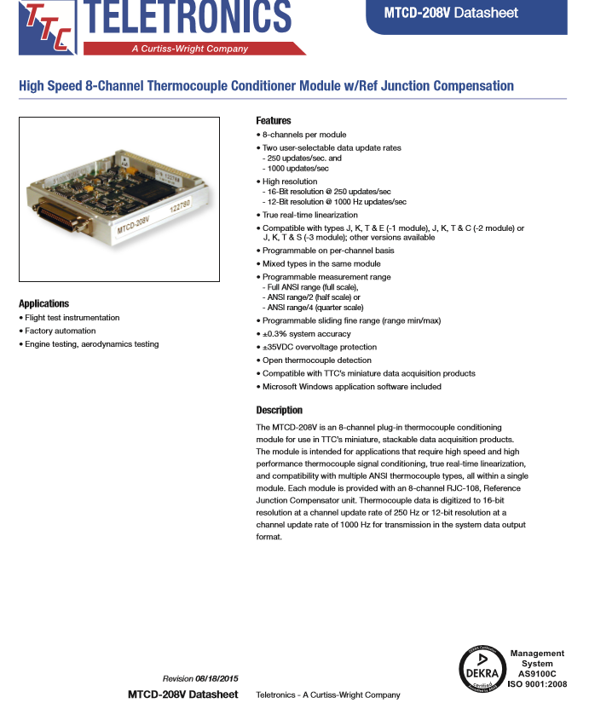
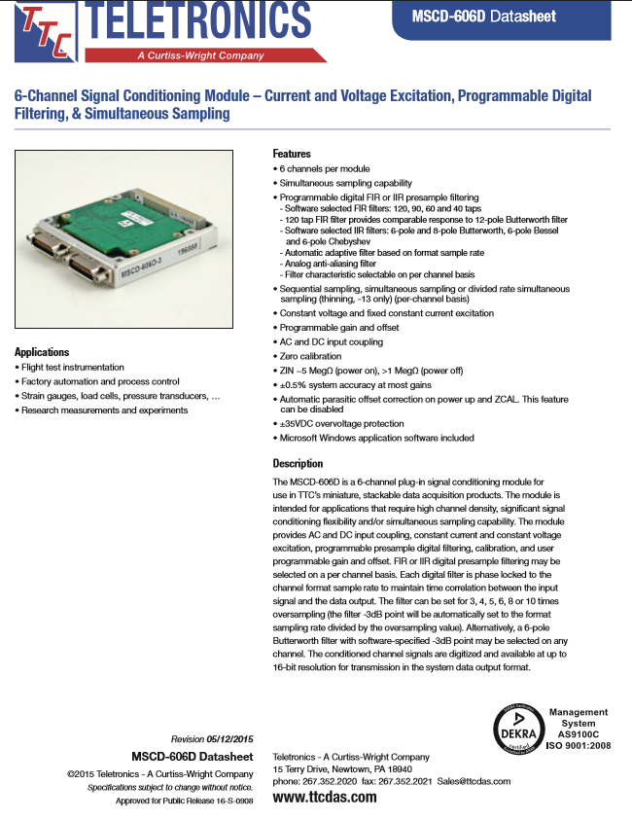
Data Acquisition Unit Modules
http://www.ttcdas.com/pdf/nonRegisteredUser/mtcd208v.pdf
http://www.ttcdas.com/pdf/nonRegisteredUser/mscd606d.pdf

Slide 13
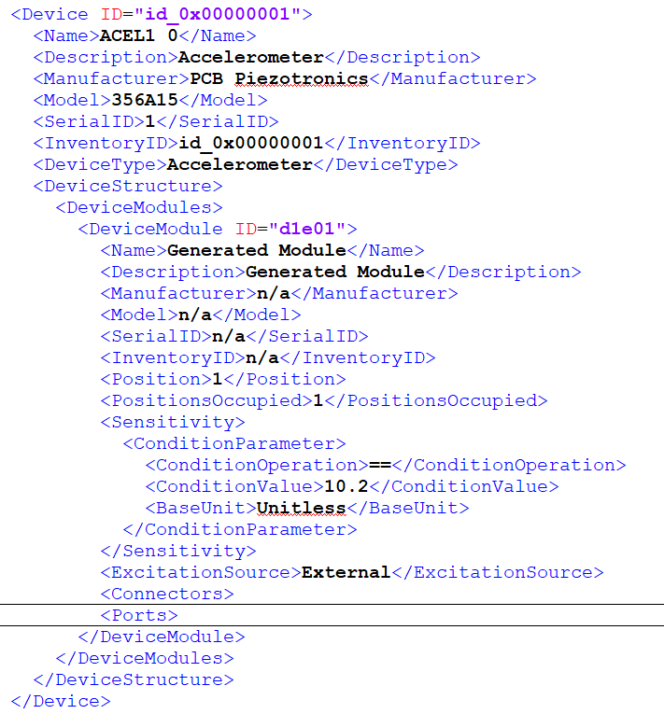
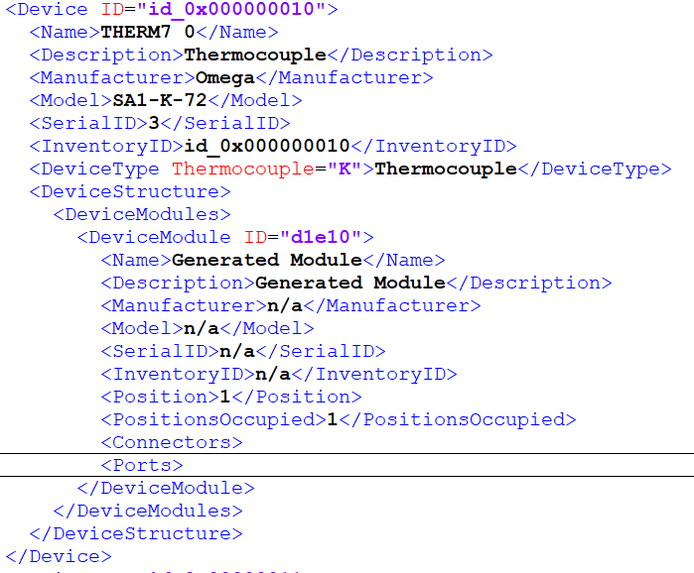
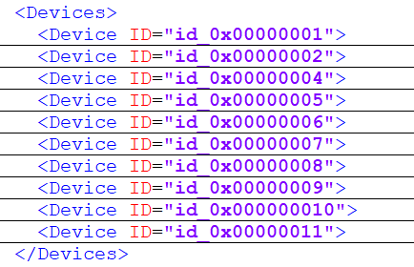
Sensors
Accelerometers
Thermocouples
Next Slide

Slide 14
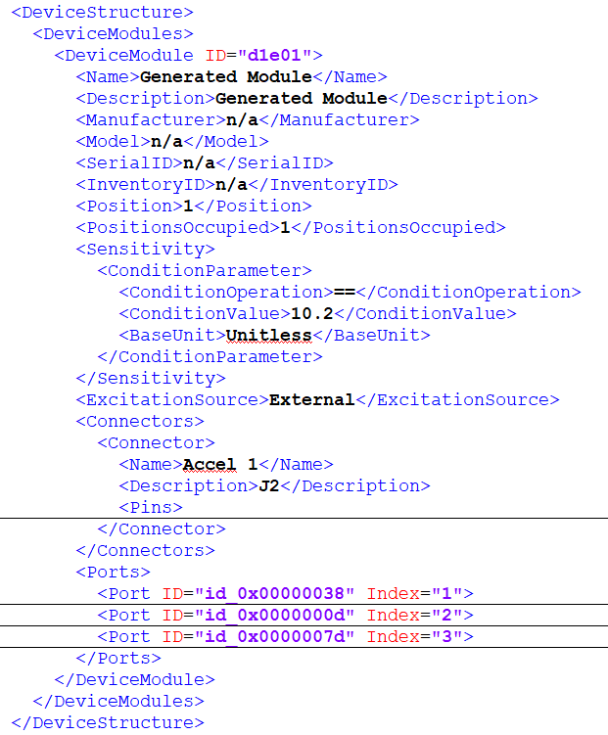
Sensor: Accelerometer
Accelerometer
Manufacturer: PCB Piezotronics
Model: 356A15
Specifications:
http://www.pcb.com/Products/model/356A15

Slide 15
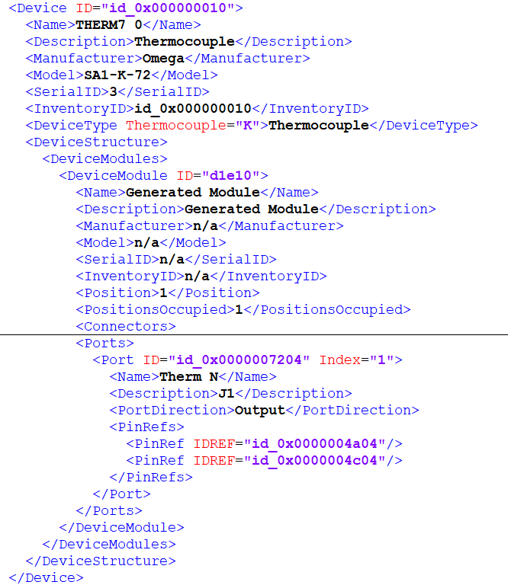
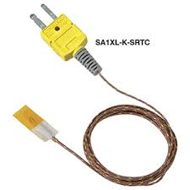
Sensor: Thermocouple
Thermocouple
Manufacturer: Omega
Model: SA1-K-72
Type: K
Specifications:
https://www.npl.washington.edu/TRIMS/sites/sand.npl.washington.edu.TRIMS/files/manuals-documentation/Omega%20-%20SA1XL%20Thermocouple.pdf

Slide 16
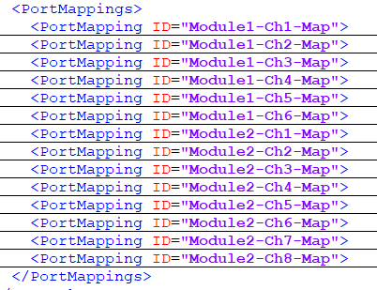
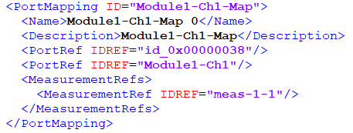
Initial MDL Representation Port Mappings
The port mapping describes the connection between a port on the accelerometer and the port on the DAU:
<PortRef IDREF="id_0x00000038"/> references a port on accelerometer “<Device ID="id_0x00000001">
<PortRef IDREF="Module1-Ch1"/> references a port on the data acquisition unit with ID <Module ID="module-1">
Note: Port Mappings describes the properties of the data that flows over that connection; in our example the measurement with IDREF=“meas-1-1” flows in the described connection.

Slide 17
Replacement DAU
Configuration for the Vendor B DAU Replacement
Sample Rate: 100 Hz
Data Length: 8-bit Resolution
2 * 4-channel thermocouple card
3 * 2-channel signal conditioner card
The objective is to configure the replacement hardware to meet the same requirements as with the TTC DAU previously used
Map measurements to ports and devices
Configure new sample rate and bit resolution
Vendor B capabilities are still within the requirements

Slide 18
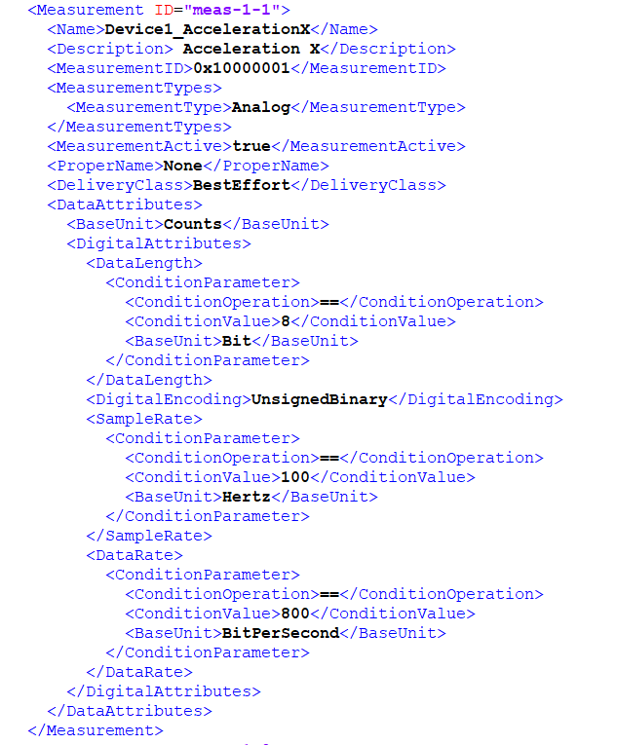
MDL Representation for Vendor B DAU Sample Rate/Data Length
The replacement cards are required to be sampled at 8-bit resolution
The replacement cards are required to be sampled at 100 Hz
Based on the above changes the Data Rate needs to be set to 800 bits/seconds

Slide 19
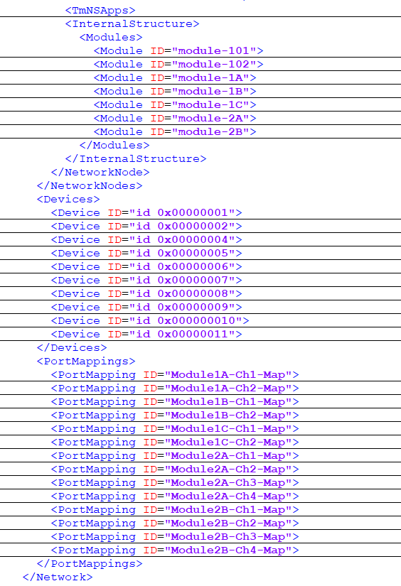
MDL Representation for Vendor B DAU
Module-1, Module-1B, and Module-1C describe the configuration of the 2-Channel Signal Conditioner cards that will acquire data from the accelerometers
Module-2A and Module-2B describe the configuration of the 4-Channel Thermocouple Conditioner cards that will acquire data from the thermocouples
Note: Configuration is obtained after requesting the inventory from the data acquisition device
Port Mappings will need to be updated appropriately to capture the new connection to the replacement DAU. The data that flows over the connection still is the same since we are measuring the same information.

Slide 20
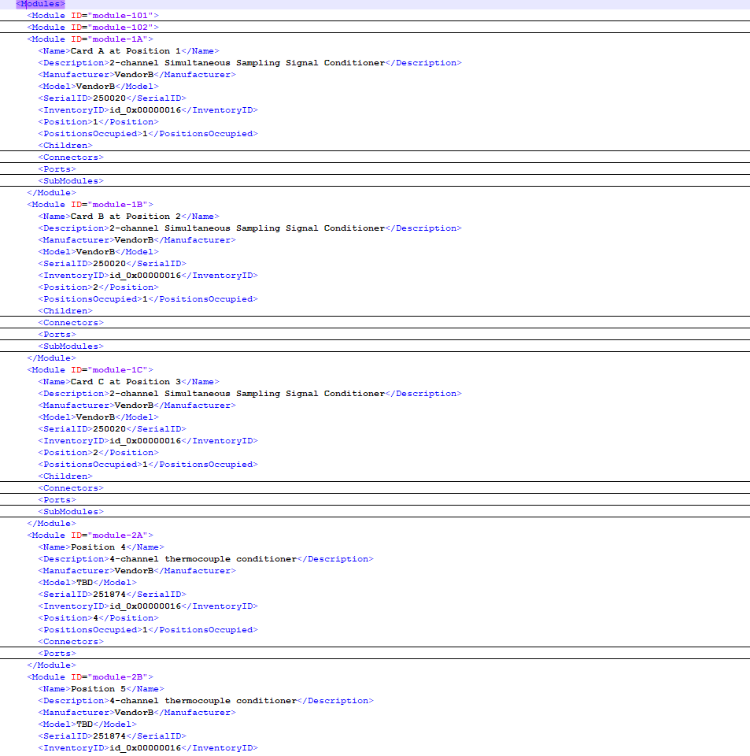
MDL Representation for Vendor B DAU
Note: Configuration is obtained after requesting the inventory from the data acquisition device

Slide 21
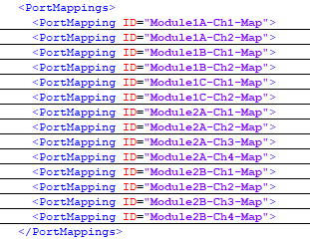
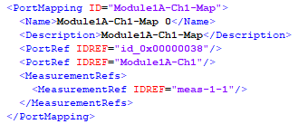
MDL Representation for Vendor B DAU Port Mappings
The port mapping describes the connection between a port on the accelerometer and the port on the DAU:
<PortRef IDREF="id_0x00000038"/> references a port on accelerometer “<Device ID="id_0x00000001">
<PortRef IDREF="Module1A-Ch1"/> references a port on the data acquisition unit with ID <Module ID="module-1A"> which is a port on the 2-channel simultaneous sampling signal conditioner replacement card.
Note 1: the measurement referenced on the port stays the same since we are measuring the same thing.
Note 2: Disregard the shape of the physical connector for our solution.

Slide 22
Cost, Value and Risk
 | COST | VALUE | RISK
Option A: Use TTC DAU Spare | DAU cost: $50,000 Expensive Option | We don’t have a lot of spares and many other programs will need to use them | Risk Level: 1 (Improbable) No much chance of this will become a problem
Option B: Order new TTC DAU | DAU Cost: $50,000 Expensive Option Time (we have to wait for the hardware) | No change in value | Risk Level: 3 (Likely) There is a chance that this may turn into a problem
Option C: Use Vendor B DAU | DAU Cost: $15,000 Significantly cheaper than previous options | We only are getting 90% of value (Vendor B DAU is slower) | Risk Level: 2 (Unlikely) There might be a chance of a problem because we having to reconfigure the hardware

Slide 23
Classic Solution
Option A and B
No MDL changes needed for this solution

Slide 24
Suggested Solution
Use available hardware in inventory and configure to satisfy original requirements
MDL Configuration file needs to be updated to reflect the new hardware configuration and connections
Review new configuration datasheets (sample rate, data length, port connections …)
Map measurements to ports and devices

